Slide 1

Deep Room Recognition Using Inaudible Echos
ubicomp '18, Sempter, 2018
QUN SONG, CHAOJIE GU, Rui Tan,
Nanyang Technological University

Slide 2
ABSTRACT
increasing need of localization by mobile application,
output 2ms single-tone inaudible chirp by speaker,
capture the echos by microphone,
a narrow inaudible band for 0.1s,
learning to capture the subtle fingerprints,
two layer nn achieve best performance,
design a RoomRecoginition cloud service and client,
infrastucture-free and no add-on hardware,
robustness against interfering sounds.

Slide 3
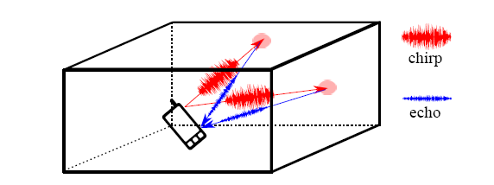
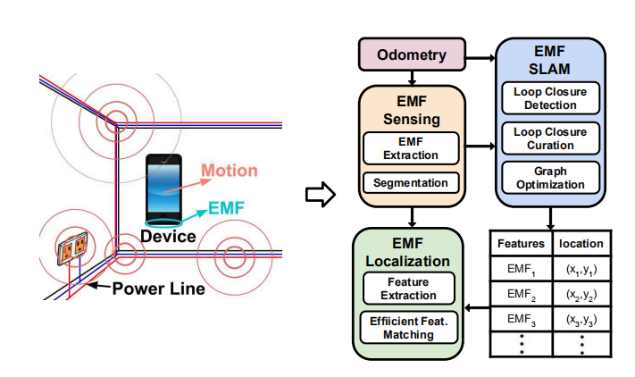
Physical perspective

Slide 4
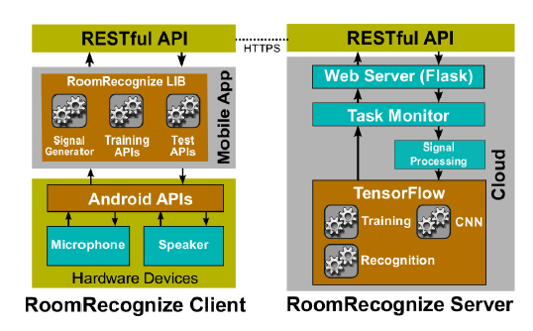
Software Framework

Slide 5
01
INTRODUCTION
02
RELATED WORK
CONTENTS
03
MEASUREMENT STUDY
04
DEEP ROOM RECOGNITION
05
DEEP ROOM RECOGNITION CLOUD SERVICE
06
Performance Evaluation
07
DISCUSSIONS
08
CONCLUSION

Slide 6

01
SECTION
INTRODUCATION

Slide 7
1. INTRODUCTION
Indoor localization,
Various RF, VL, imaging, acoustics, geomagnetism,
Each sensing modality bears limitation,
this paper design room-level localization approach
for off-the-shelf smartphones using audio system

Slide 8
1. INTRODUCTION
Room level localization desirable widely
The requirement of existing indoor localization
R1.dedicated/existing infrastasture
R2.add-on equipment
R3.(training)process for data
acoustic-based room-level localization
only R3
casted into a supervised multiclass classification problem
easy training data collection(enter,click,key),no-expert

Slide 9
1. INTRODUCTION
existing indoor localization system incorporated acoustic sensing
SurroudSense(only outperform random guessing, wide audible band, susceptible ambient)
Two basic challenge to room recoginition system
privacy concern
20khz annoyance
limited information about the measured room

Slide 10
1. INTRODUCTION
The emerging DL methods demonstrated in image classification, speech recognition, NLP and etc,
This paper present the design of a deep room recognition approach,
The experiment shows a two-layer CNN fed with spectrogram of the captured inaudible echos achieves the best performance,
100ms audio recording after a 2ms 20khz single-tone chirp
Notes:
batphone 需要10秒的声音文件长度，对隐私问题就不是很好；

Slide 11
1. INTRODUCTION
The contributions
in-depth measurement study on rooms' acoustic responses to a short-time single-tone inaudible chirp,
design of deep model,
evaluation of our approach in real-world,
engineer implement,
Notes:
chirp信号是，频率随着时间变化；

Slide 12
02
SECTION
RELATED WORK

Slide 13
2. RELATED WORK
infrastructure-dependent
RF infrastructure, 802.11[8,18], cellular[20], FM radio[10], aircraft broadcast[15],
WALRUS inaudible beacons to localize mobile,
infrastructure-free
geomagnetism[11], imaging[13], acoustics
acoustics divided into
passive sensing, surroundsense[36]
active sensing,
senmantic location[16,24,34]
RoomSense[31],audible,0.68s,SVM, MFCC

Slide 14
2. RELATED WORK
active acoustic sensing
ranging, BeepBeep[30], SwordFight[40],
moving object tracking, finger[38],breath[28], a human body using inaudible chirp[29],
gesture recognition,Soundwave[17], doppler-shifted reflection.

Slide 15
03
SECTION
MEASUREMENT STUDY

Slide 16
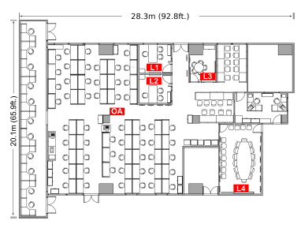
3. MEASUREMENT STUDY
lab, measured room 'Lx', opern area 'OA'

Slide 17
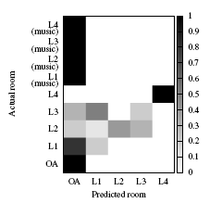
3.1 Passive Acoustic Sensing
confusion matrix of batphone
Notes:
Batphone，看出
Guoguo, infrastructure acoustic can obtain high accuracy

Slide 18
3.2 Rooms' response to single-tone chirps
use loudspeaker to emit an acoustic chirp and use microphone to capture the measured room's response,
conduct measurement study to obtain insightful observations on the rooms' responses,
every 100ms emit a time duration of 2 ms chirp wave
44.1khz sample rate
chirp not overlap echos 34cm away
Notes:
每个房间选两个点，每个点放一个手机，运行程序半小时，以达到足够的统计意义；第6小节调查了最小训练数据量；

Slide 19
3.2 Rooms' response to single-tone chirps
existing active acoustic sensing, sine sweep chirp, maximum length sequence, multi-tone chirp,
propose use a sine-tone inaudible chirp to avoid the annoyance to the user and improve the robustness of the room recognition against interfering sounds,
Notes:
每个房间选两个点，每个点放一个手机，运行程序半小时，以达到足够的统计意义；第6小节调查了最小训练数据量；

Slide 20
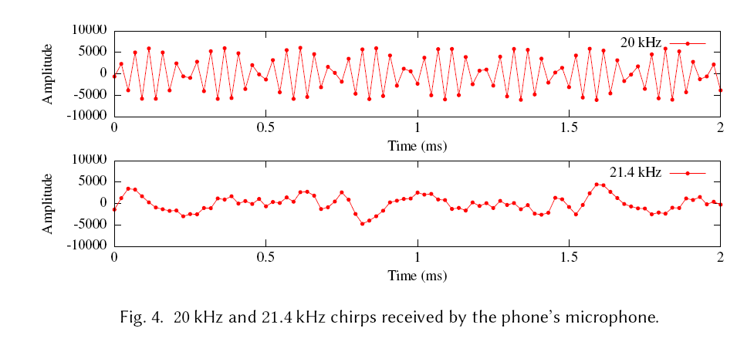
3.2 Rooms' response to single-tone chirps
20khz and 21.khz chirp
Notes:
高于20khz之后，回音的畸变很大，

Slide 21
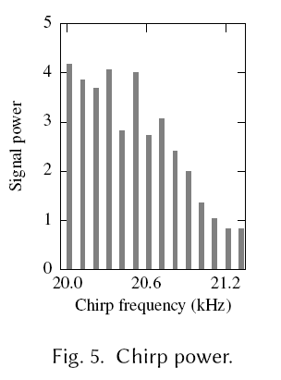
3.2 Rooms' response to single-tone chirps
The decreasing trend indicates that audio system's performance decrease with the frequency.
choose 20khz, the lowest inaudible frequency,
android Near Ultrasound Tests
Notes:
高于20khz之后，回音的畸变很大，
声音总可以被分解为不同频率不同强度正弦波的叠加。这种变换（或分解）的过程，称为傅里叶变换。
一般的声音总是包含一定的频率范围。
人耳可以听到的声音的频率范围在20到2万赫兹（Hz）之间。
高于这个范围的波动称为超声波，而低于这一范围的称为次声波。

Slide 22
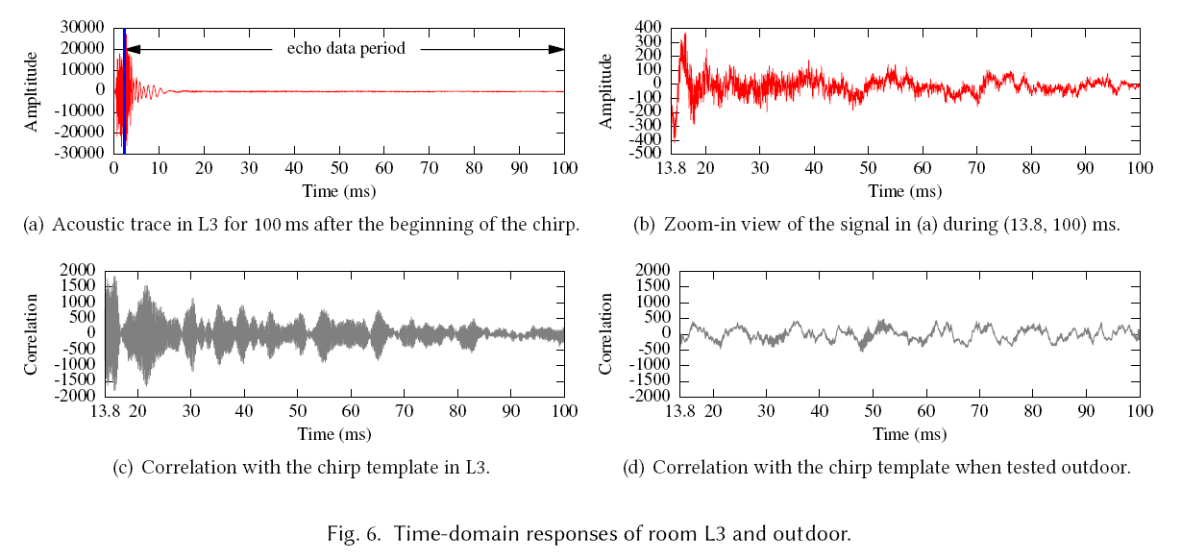
3.2 Rooms' response to single-tone chirps
2ms,0.5ms
97.5ms echo data period
13.8ms
in L3 and outdoor
corrletion relationship
Notes:
高于20khz之后，回音的畸变很大，
声音总可以被分解为不同频率不同强度正弦波的叠加。这种变换（或分解）的过程，称为傅里叶变换。
一般的声音总是包含一定的频率范围。
人耳可以听到的声音的频率范围在20到2万赫兹（Hz）之间。
高于这个范围的波动称为超声波，而低于这一范围的称为次声波。

Slide 23
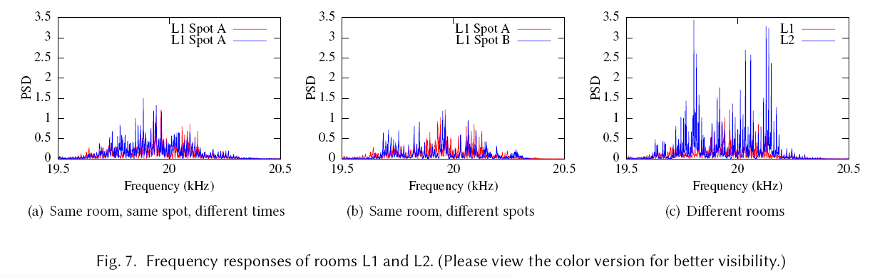
3.2 Rooms' response to single-tone chirps
Frequency-domain analysis
guess different rooms have different freqency responses
97.5ms, 10.3hz
Notes:
4s语音数据，用来手机数据，40个回音数据周期，可能会引起隐私问题，增加计算负载；
最小化处理语音计算的时间来减少隐私问题和计算负载；

Slide 24
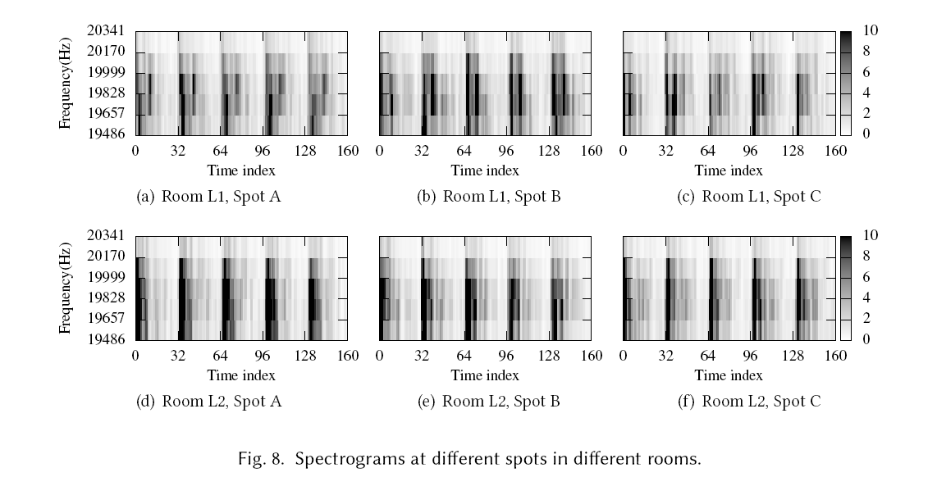
3.2 Rooms' response to single-tone chirps
Frequency-domain analysis
guess different rooms have different freqency responses
97.5ms, 10.3hz
Notes:
4s语音数据，用来手机数据，40个回音数据周期，可能会引起隐私问题，增加计算负载；
最小化处理语音计算的时间来减少隐私问题和计算负载；

Slide 25
04
SECTION
DEEP ROOM RECOGNITION

Slide 26
4.1 Background and Problem Statement
Traditional classification algorithm
bayes classifier and SVM
dimension reduction
MFCC, PLP coefficient

Slide 27
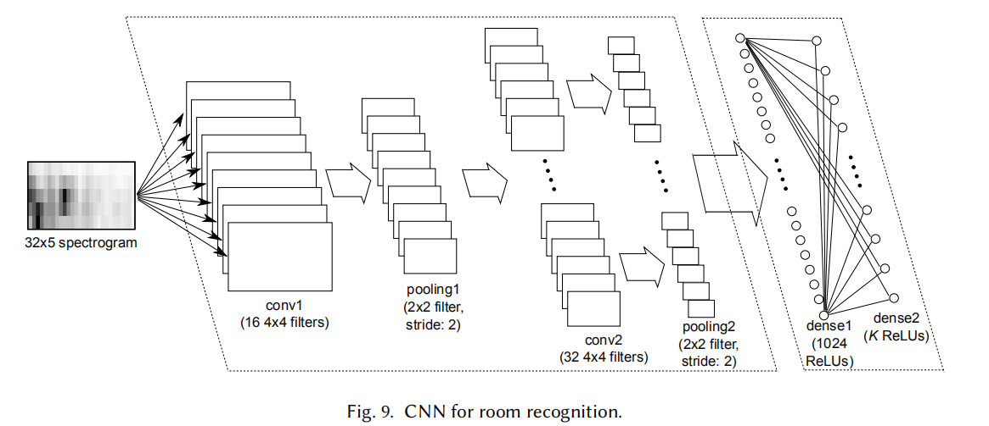
4.2 Raw Data Format/Deep Model
PSD and spectrogram are two possible raw data formats for deep learning
FFT on the 4300 data points in the echo data
use 147 points in the [19.5,20.5]khz

Slide 28
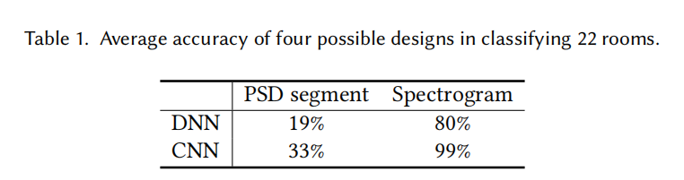
4.2 Raw Data Format/Deep Model
22000samples from 22 rooms, every sample 100ms
training set, validation set and testing set

Slide 29
4.3 Hyperparameter Settings
Notes:
理论上是可以通过优化图来解决SLAM的问题；但是实际上，SLAM框架对false positive比较敏感；
提出新的方法来解决；

Slide 30
05
SECTION
DEEP ROOM RECOGNITION CLOUD SERVICE

Slide 31
5.1 System Overview
RoomRecognition support a participatory learning mode, in which CNN is retrained when a mobile client uploads labeled training samples
existing studies shows that smartphones and even lower-end IoT platform can run deep models
Notes:
1、经常会离线

Slide 32
06
SECTION
PERFORMANCE EVALUATION

Slide 33
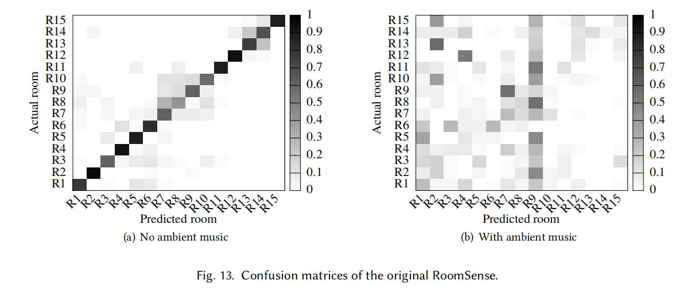
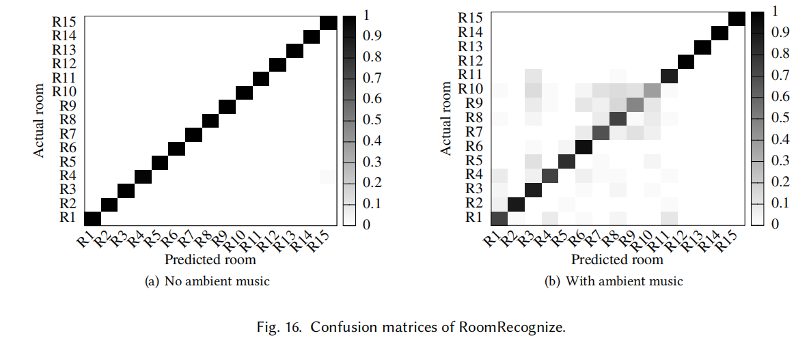
6.1 Evaluation Methodology
low performance of passive acoustic sensing
only compare RoomRecognize with other based on active acoustic sensing, RoomSense

Slide 34
07
SECTION
DISCUSSIONS

Slide 35
7 DISCUSSIONS
Moving people in target rooms results in RoomRecognize's performance because of human body
To address this issue, other sensing modality geomagnetism, in future,
Similar room worth study

Slide 36
08
SECTION
CONCLUSION

Slide 37
8 CONCLUSION
To address the challenges of limited information carried by the room's response in such a narrow band, applied deep learning capture the subtile difference in room's reponses.
two-layer CNN fed with the spectrogram of the echo
RoomRecognize

Slide 38
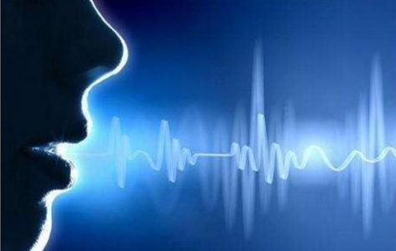

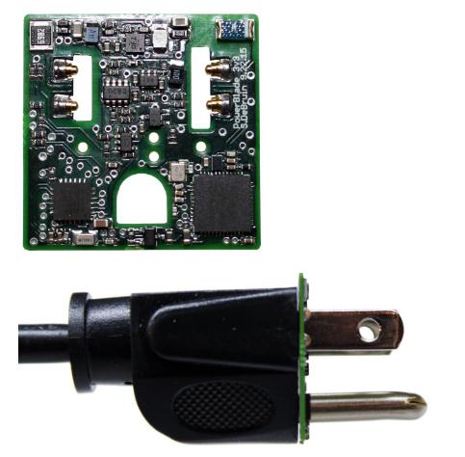
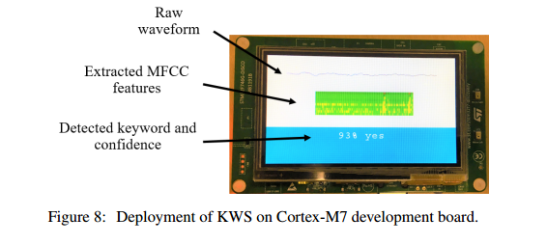
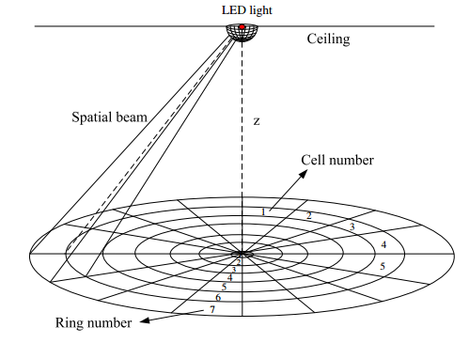

Slide 39
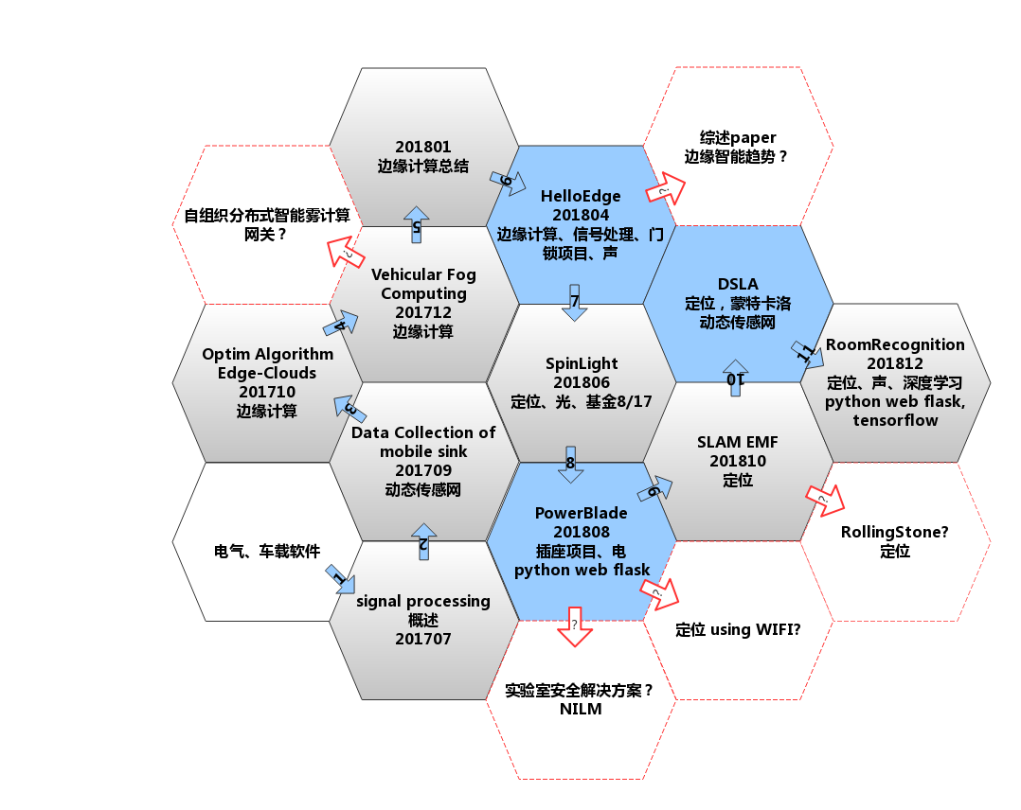

Slide 40
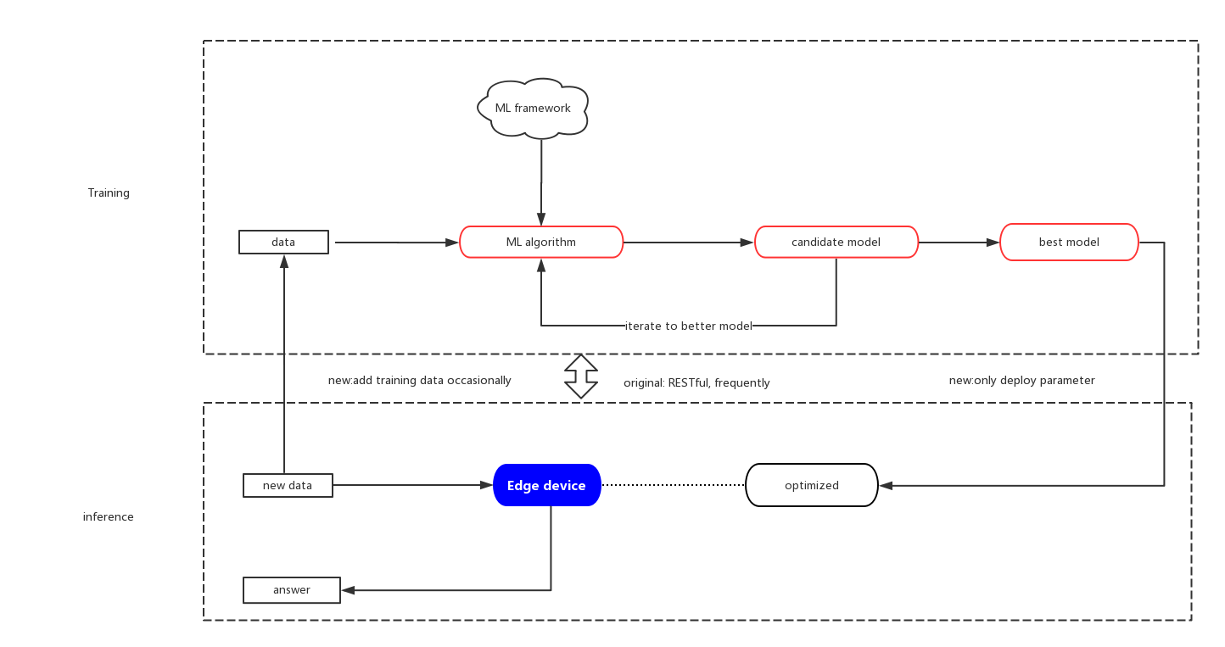
Software Framework

Slide 41
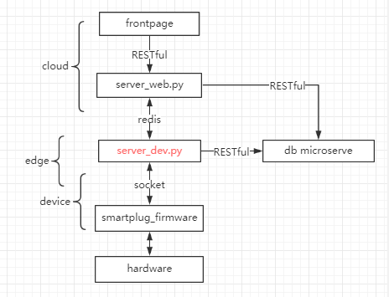

Slide 42
Thank you!

